Slide 1

Stalin & Hitler: Treacherous Alliance
Stalin and Hitler, ideologically opposed leaders, forged a complex, treacherous relationship that profoundly shaped World War II. Initial interactions involved suspicion.
DEV
Dr. Eleanor Vance
February 11, 2026
Notes:
Joseph Stalin and Adolf Hitler, leaders of ideologically opposed regimes, forged a complex and ultimately treacherous relationship. Their initial interactions were marked by deep suspicion and strategic maneuvering, setting the stage for major conflicts and shaping the course of World War II.

Slide 2

Molotov-Ribbentrop Pact
Signed on August 23, 1939, this non-aggression treaty between Nazi Germany and the Soviet Union shocked the world. It included secret protocols dividing Eastern European territories.
Notes:
The Molotov-Ribbentrop Pact was a non-aggression treaty signed on August 23, 1939, between Nazi Germany and the Soviet Union. Its existence shocked the international community, especially given the ideological opposition between the two regimes. The pact also contained secret protocols that detailed the division of Central and Eastern European territories into German and Soviet spheres of influence, fundamentally altering the geopolitical landscape on the eve of World War II. It was a strategic, temporary alliance driven by mutual interests rather than shared ideology.

Slide 3
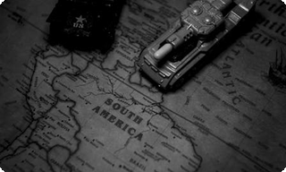
Stalin's Strategic Rationale
01
Military Modernization
02
Territorial Expansion
The pact provided a crucial period for the Soviet Union to enhance its military capabilities and prepare for future confrontation with Germany.
The secret protocols allowed the USSR to annex parts of Eastern Poland, the Baltic states, and exert influence over Finland, expanding its western frontier.
Notes:
Stalin viewed the non-aggression pact as a temporary but necessary measure. His primary aim was to gain valuable time for the Soviet military to modernize and rearm, anticipating an eventual conflict with Nazi Germany. Additionally, the pact's secret protocols presented a unique opportunity for significant territorial gains in Eastern Europe, reinforcing Soviet borders and expanding influence. These strategic benefits were paramount to his decision-making.

Slide 4

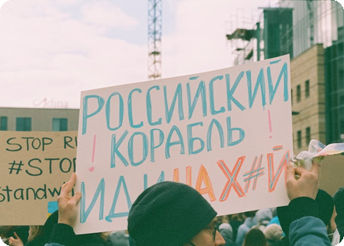
Hitler's Motives for the Pact
Hitler's primary motivation for the Molotov-Ribbentrop Pact was to secure Germany's eastern flank, preventing a devastating two-front war.
Focus Military Efforts
The pact enabled Germany to concentrate its forces on the invasion of Poland and subsequent campaigns in Western Europe.
Temporary Alliance
Hitler viewed the non-aggression pact as a strategic, short-term measure to buy time for future expansion eastward.
Notes:
Hitler's strategic motivations for the Molotov-Ribbentrop Pact were primarily to avoid a costly two-front war. By neutralizing the Soviet threat in the east, Germany could dedicate its full military might to invading Poland and then focusing on Western Europe without immediate Soviet intervention. Hitler considered the pact a temporary measure, a tactical pause before eventually pursuing his long-term expansionist goals eastward. This allowed him to consolidate power and resources before his ultimate betrayal.

Slide 5
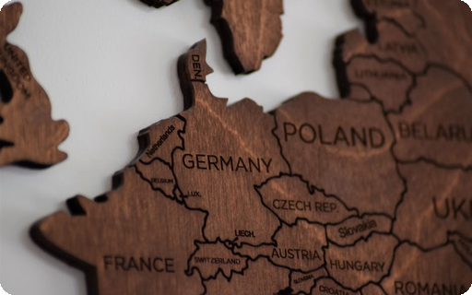
Poland's Invasion and Division
The immediate consequence was the joint invasion and division of Poland in September 1939. Soviet forces occupied the east, and Germany took the west, marking the official start of World War II in Europe.
Notes:
The Molotov-Ribbentrop Pact, signed just weeks before, laid the groundwork for this devastating event. On September 1, 1939, Germany invaded Poland from the west, followed by the Soviet Union from the east on September 17. This coordinated invasion and subsequent division of Polish territory between the two powers officially ignited World War II in Europe, shattering peace and initiating a period of immense global conflict and suffering.

Slide 6

Economic Exchange under the Pact
From 1939-1941, the Soviet Union supplied oil, grain, and minerals to Nazi Germany. This vital economic exchange fueled Germany's war machine, enabling its conquest of Western Europe.
Notes:
During the Molotov-Ribbentrop Pact, specifically between August 1939 and June 1941, the Soviet Union provided significant raw materials to Nazi Germany. These included crucial resources such as oil, grain, and various minerals. This economic support was instrumental in sustaining Germany's military efforts and its rapid territorial expansion across Western Europe. The supplies allowed Germany to circumvent blockades and maintain its industrial output for the war.

Slide 7
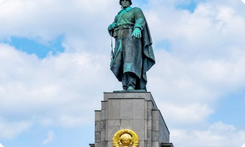
Hitler's Secret Plans: Soviet Border
01
Conquest Plans Maintained
02
Troop Build-up on Border
Hitler harbored long-term plans for conquering Soviet territories even after signing the non-aggression pact, a clear act of deception.
Germany began to mass troops along the Soviet border, intensifying the geopolitical landscape and signaling impending conflict.
03
Stalin's Dismissal of Warnings
Stalin reportedly dismissed numerous intelligence warnings about an impending German invasion, failing to adequately prepare for the assault.
Notes:
Hitler's strategic goals for conquering Soviet territories remained, even after the non-aggression pact. Germany's substantial troop build-up along the Soviet border created immense tension, clear signs of an impending invasion. Despite numerous intelligence warnings, Stalin reportedly dismissed them, believing they were British provocations. This critical misjudgment set the stage for a devastating conflict.

Slide 8
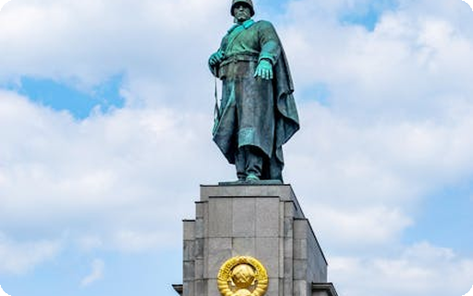
Operation Barbarossa: Pact Broken
Germany's Operation Barbarossa on June 22, 1941, violently ended the non-aggression pact. This invasion forced the USSR to join the Allies, drastically shifting WWII's trajectory and revealing the pact's cynical core.
Notes:
On June 22, 1941, Germany initiated Operation Barbarossa, a large-scale invasion of the Soviet Union. This act of aggression shattered the Molotov-Ribbentrop Pact, a non-aggression agreement previously signed between the two powers. The Soviet Union's forced entry into the Allied camp profoundly reshaped the strategic landscape of World War II, marking a critical turning point and exposing the opportunistic foundation of the earlier pact.

